Slide 1
Intelligent Classification of Rural Infrastructure Project under PMGSY
CAPSTONE PROJECT
Presented By:
Student name : PADALA JAYANTH
College Name & Department : CENTURION UNIVERSITY OF TECHNOLOGY ANAD MANAGEMENT – COMPUTER SCIENCE ENGINEERING

Slide 2
OUTLINE
Problem Statement
Technology used
Wow factor
End users
Result
Conclusion
Git-hub Link
Future scope
IBM Certifications

Slide 3
Problem Statement
The Pradhan Mantri Gram Sadak Yojana (PMGSY) is a flagship Indian Government scheme aimed at developing rural road infrastructure to ensure all-weather connectivity to unconnected villages.
Over time, the PMGSY scheme has evolved into multiple phases:
PMGSY-I,PMGSY-II,RCPLWEA, etc.
Each of these sub-schemes has unique objectives, funding rules, technical specifications, and monitoring protocols.
Key Problem:
Thousands of road and bridge construction projects need to be classified into the correct scheme. Manual classification is:
Time-consuming
Error-prone
Not scalable
Proposed Solution:
To solve this challenge, we developed a machine learning model using IBM AutoAI that takes project characteristics (length, cost, duration, etc.) and predicts the appropriate PMGSY scheme. This automates classification and speeds up decision-making in government departments.

Slide 4
Technology used
IBM Watson Studio – for AutoAI model building
IBM AutoAI – for automated machine learning pipeline generation
IBM Cloud Object Storage – for uploading and managing datasets
IBM Watson Machine Learning – for model deployment and serving
Dataset Source – AI-KOSH Dataset for PMGSY

Slide 5
IBM cloud services used
The following IBM Cloud services were used to implement this solution:
1. Watson Studio
Provides a Jupyter Notebook and AutoAI interface for developing and evaluating machine learning models.
2. AutoAI
AutoAI automatically:
Preprocesses the data
Selects suitable ML algorithms
Performs hyperparameter optimization
Ranks models based on accuracy and other metrics
3. Cloud Object Storage
Used to upload and store the .csv dataset containing project data.
4. Watson Machine Learning (WML)
Used to deploy the trained model as an API for real-world inference and integration into apps or dashboards.

Slide 6
Wow factors
What makes this project innovative and impactful?
Auto-classification of infrastructure projects with high accuracy
Uses AutoAI – no manual code needed for model selection or optimization
Reduces classification time from hours to seconds
Enhances transparency and accuracy in fund allocation under PMGSY
Can be deployed as a REST API for integration into government dashboards
Model is continuously improvable with new data

Slide 7
End users
This AI-based classification model can be used by:
Government Planning Officers – For monitoring and scheme assignment
Rural Development Department Officials – To track compliance and progress
Data Analysts in Public Sector – For visualizing and reporting on infrastructure projects
MIS Dashboard Developers – To integrate predictions into real-time decision systems

Slide 8
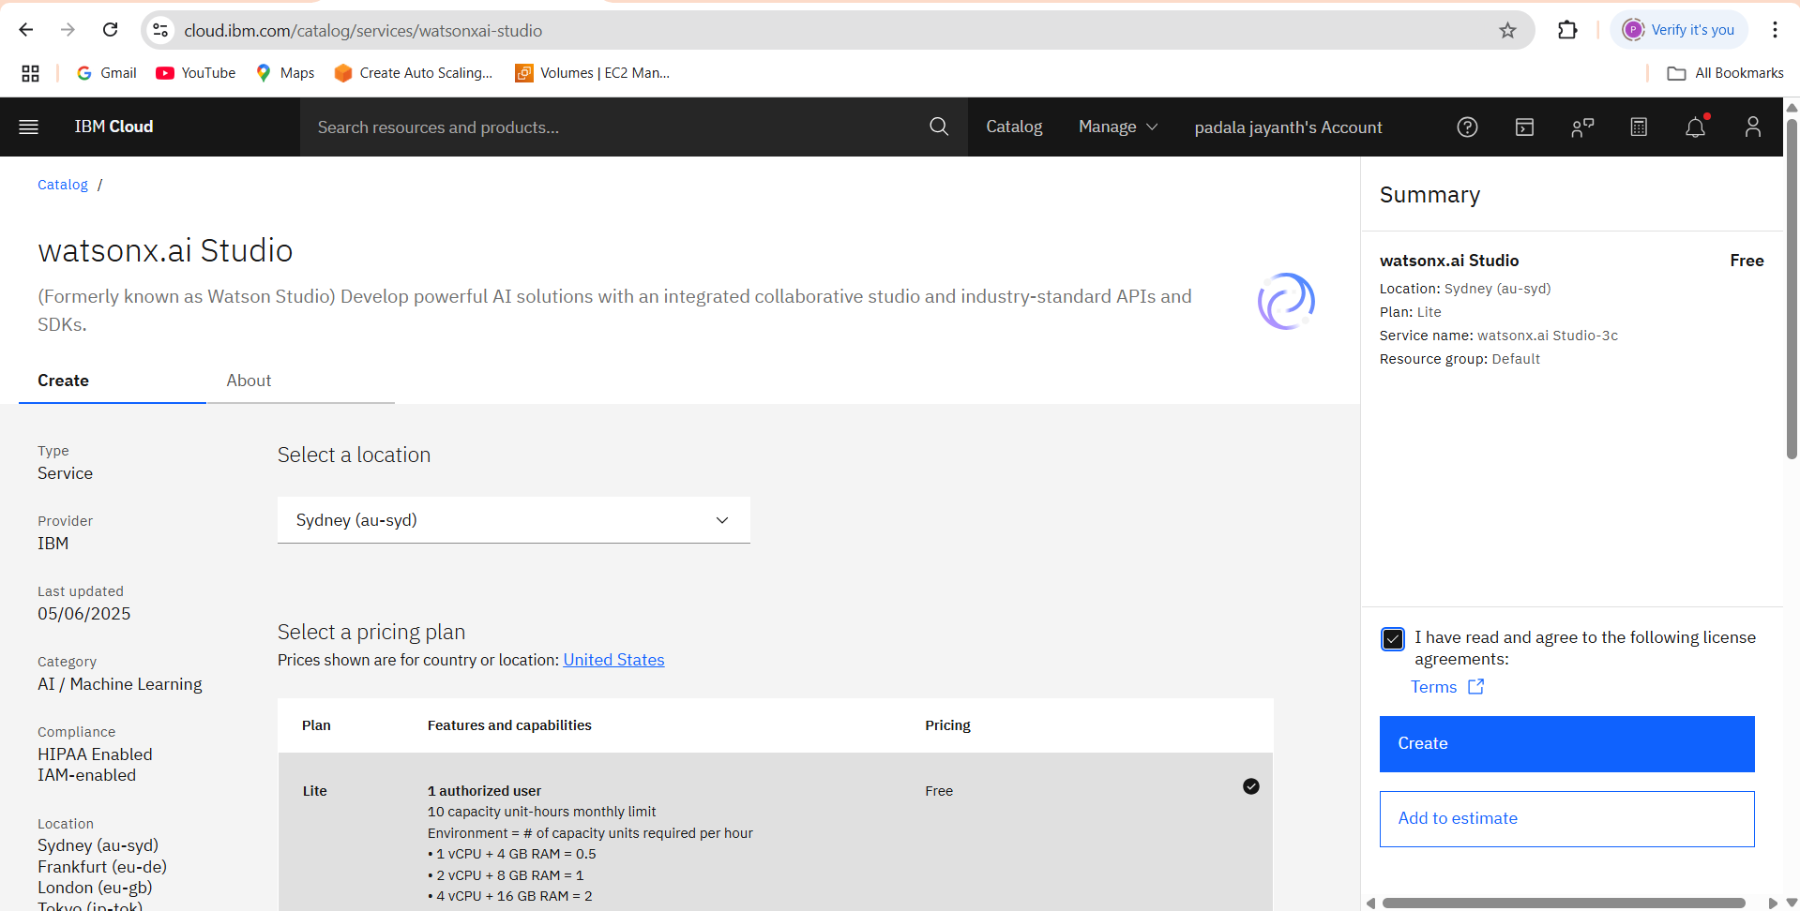
Results
CREATING WATSONX.AI STUDIO

Slide 9
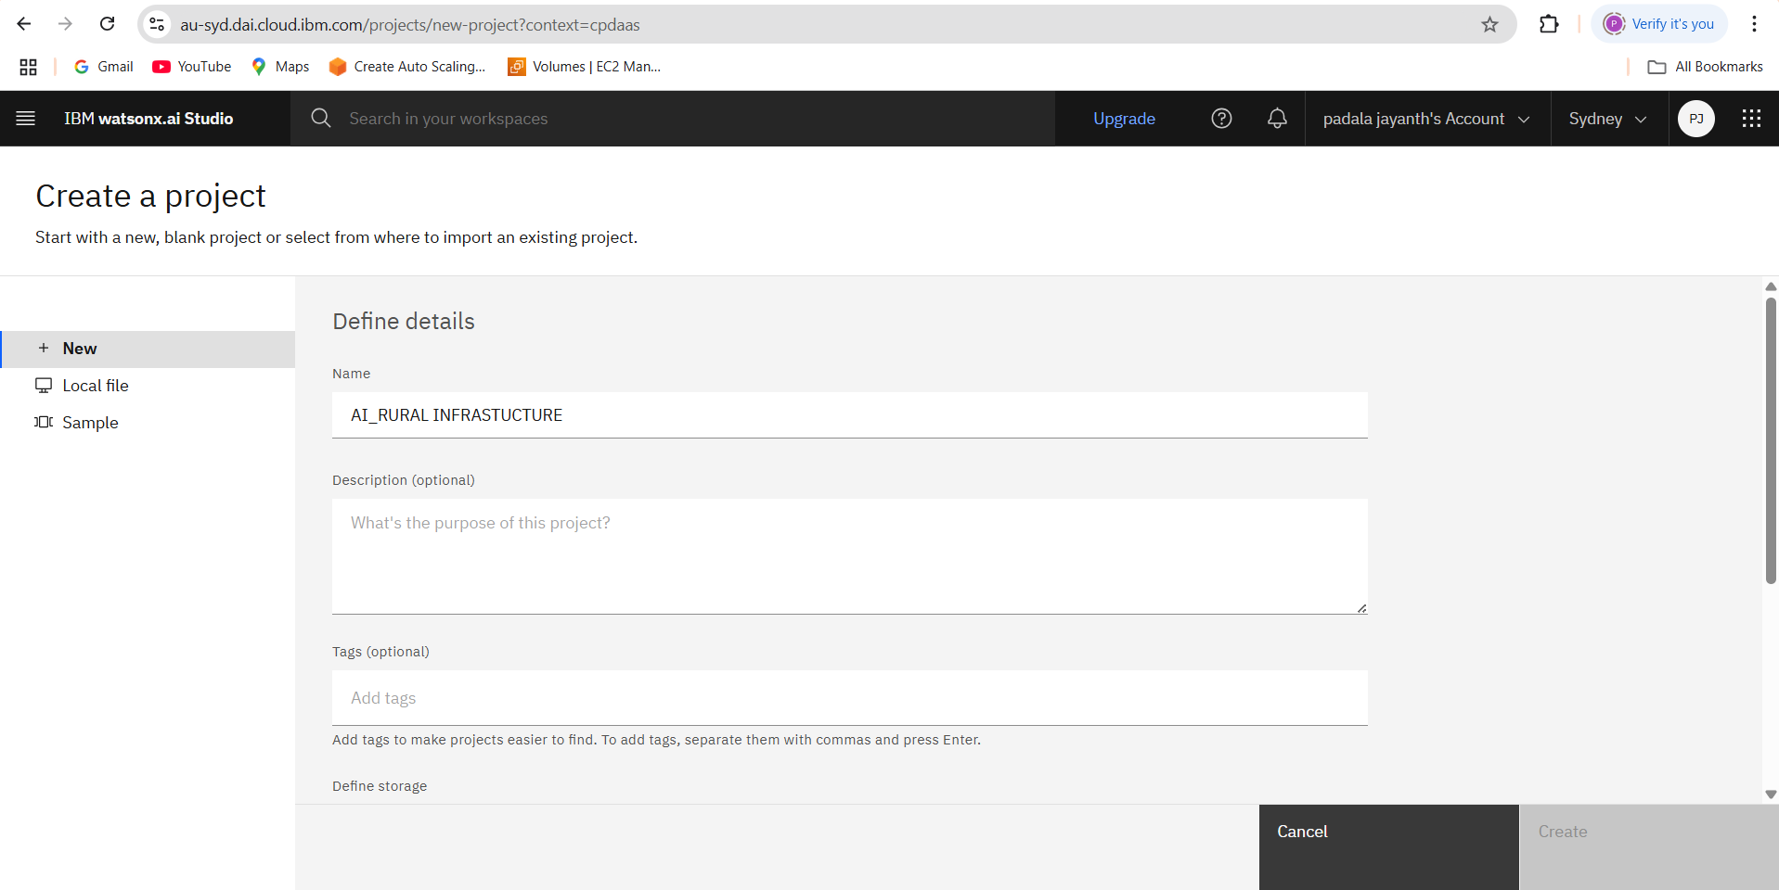
Results
CREATING A PROJECT IN WATSONX AI

Slide 10
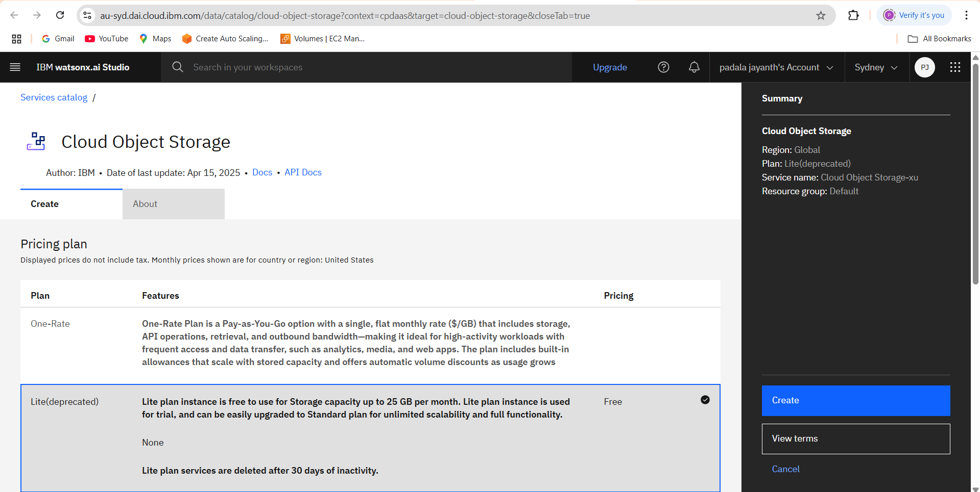
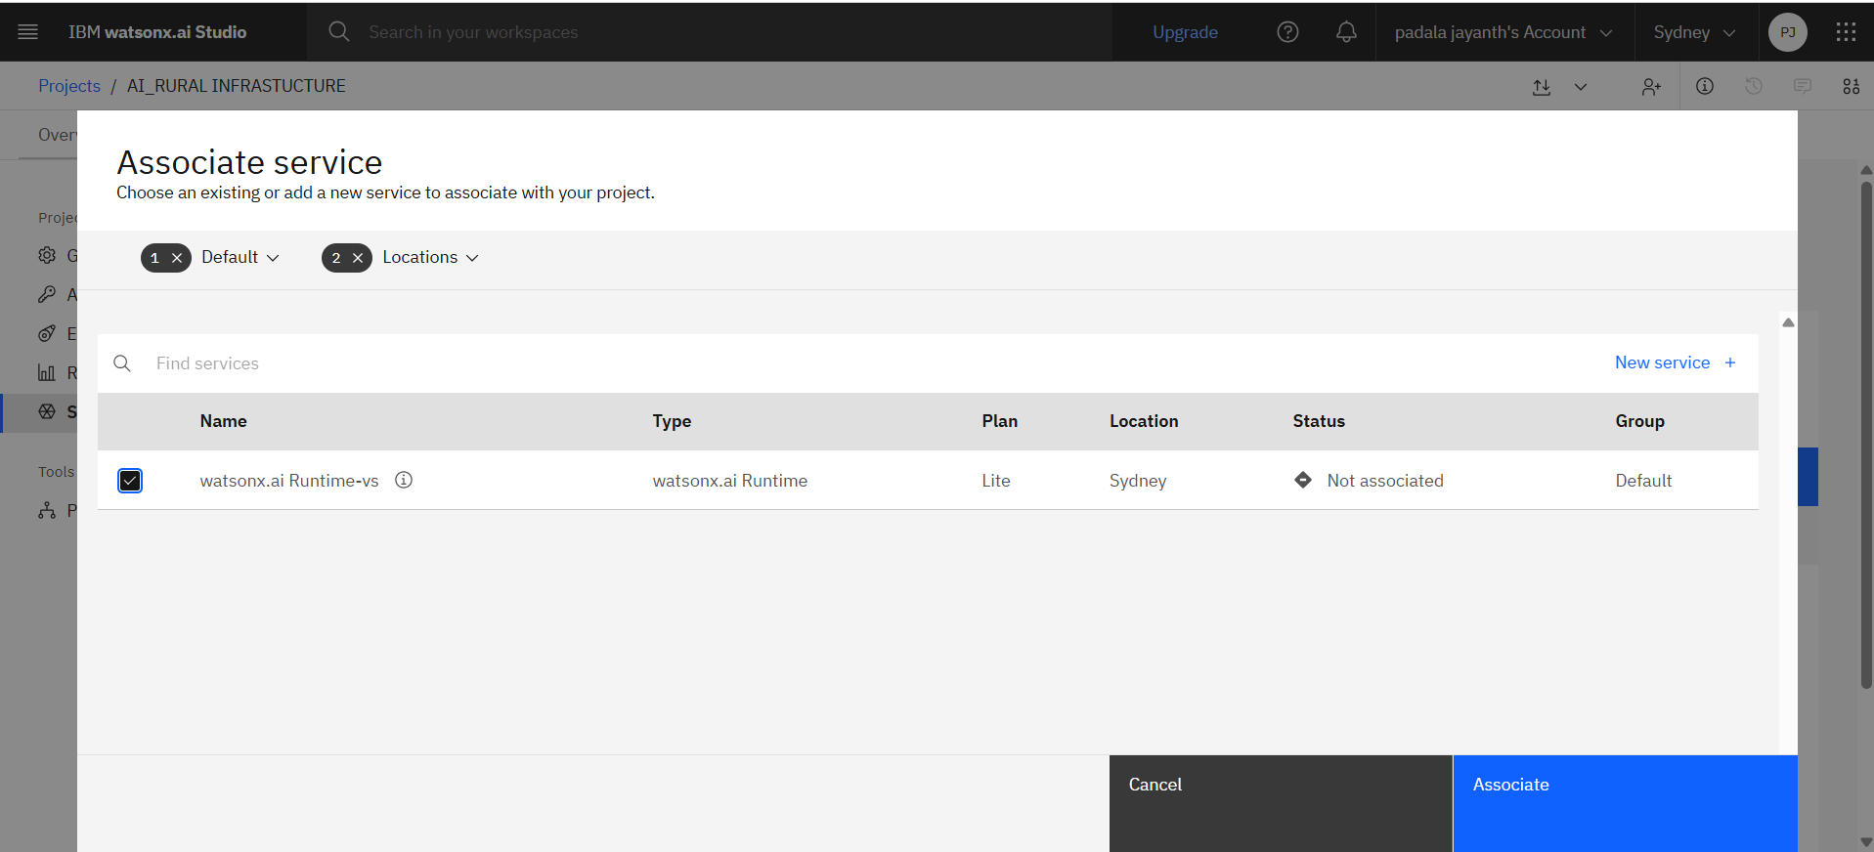
Results
CREATING CLOUD STORAGE OBJECT & ASSOCIATE SERVICE

Slide 11
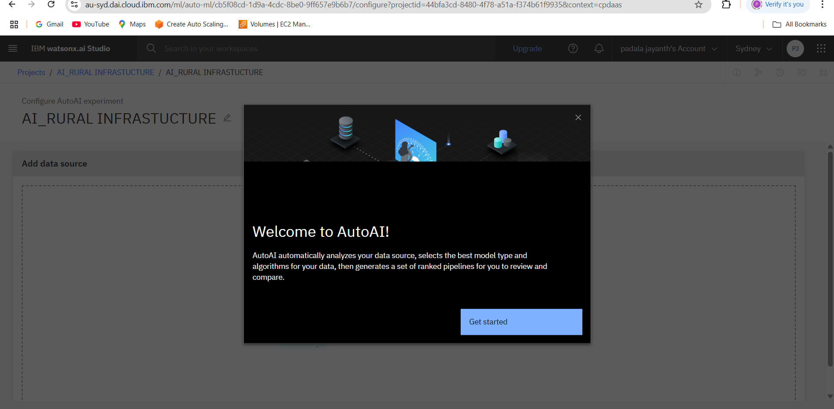
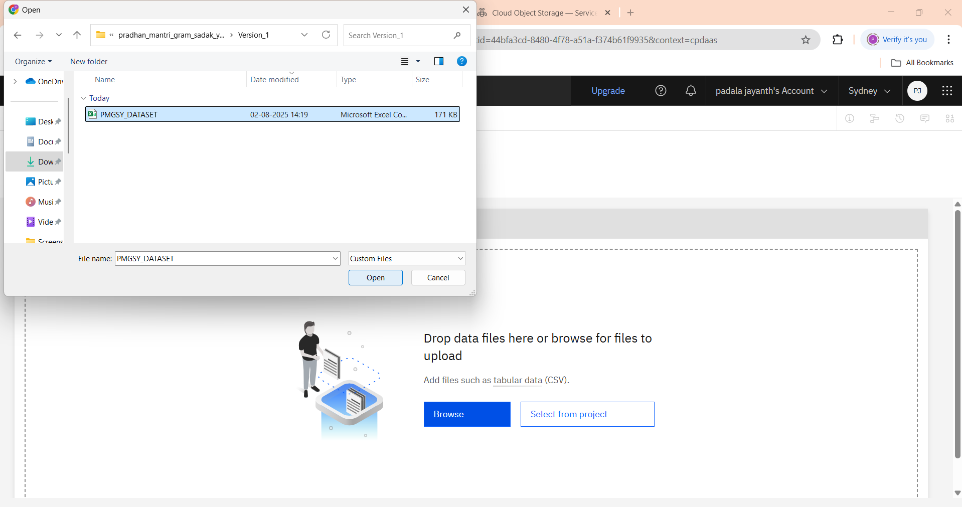
Results
AUTO AI & UPLOAD DATASET

Slide 12
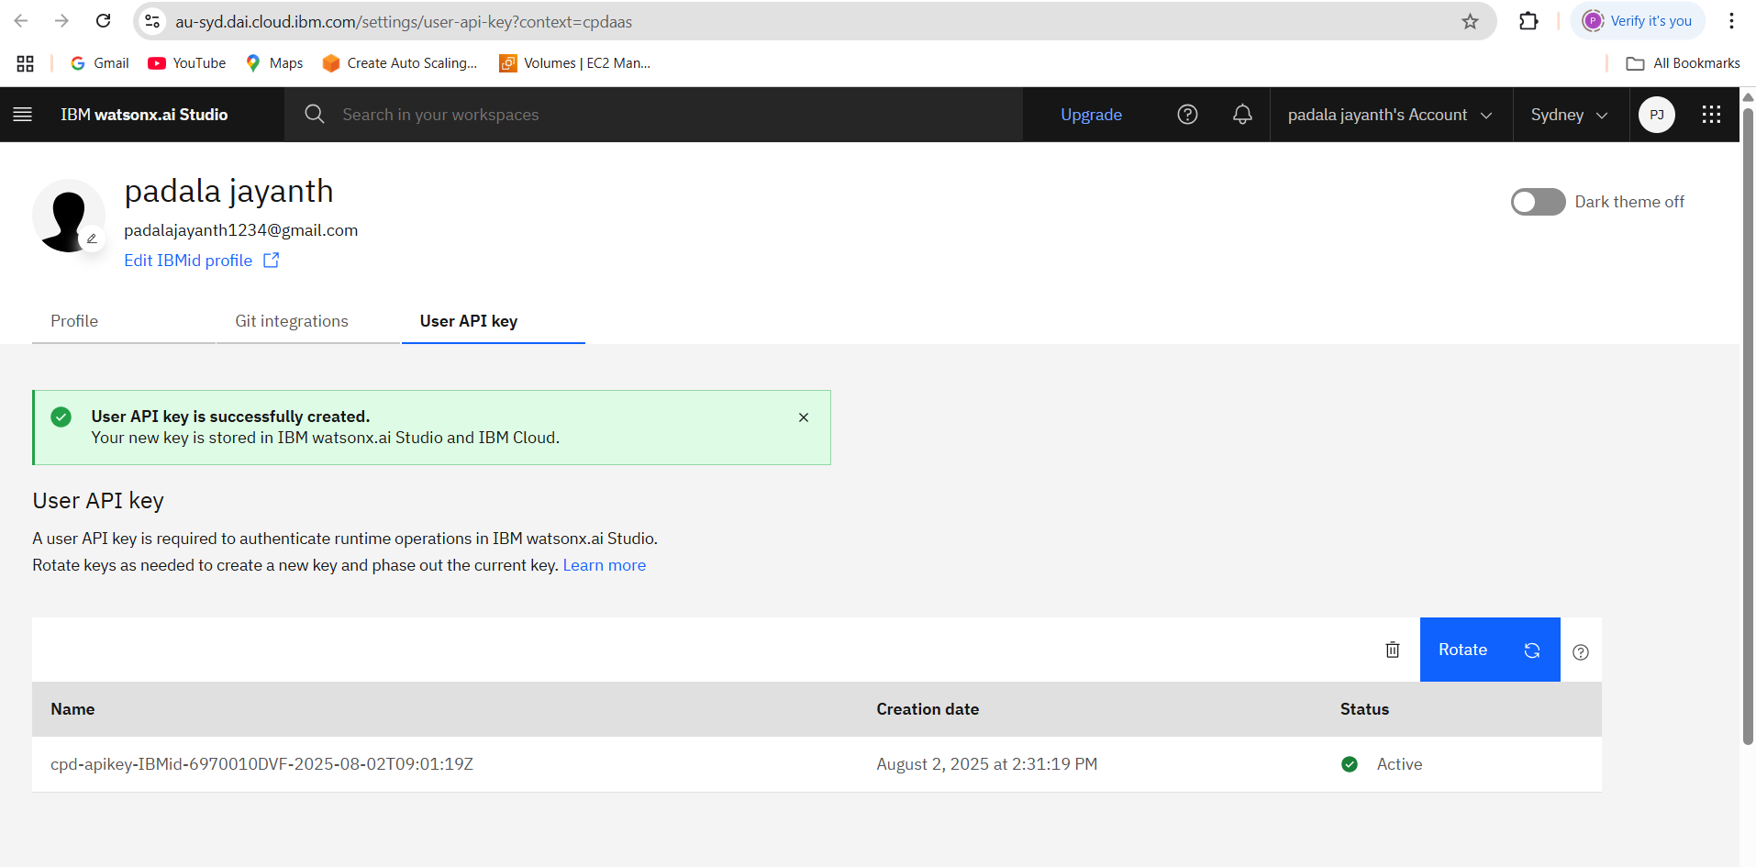
Results
CREATING USER API

Slide 13
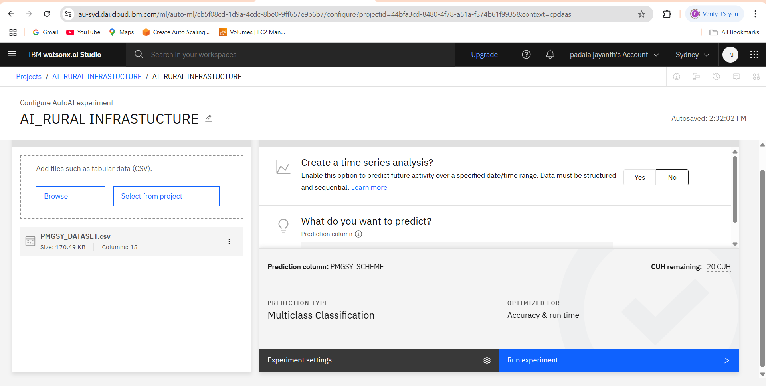
Results
SELECTING PREDICTING COLUMN:-PMGSY_SCHEME

Slide 14
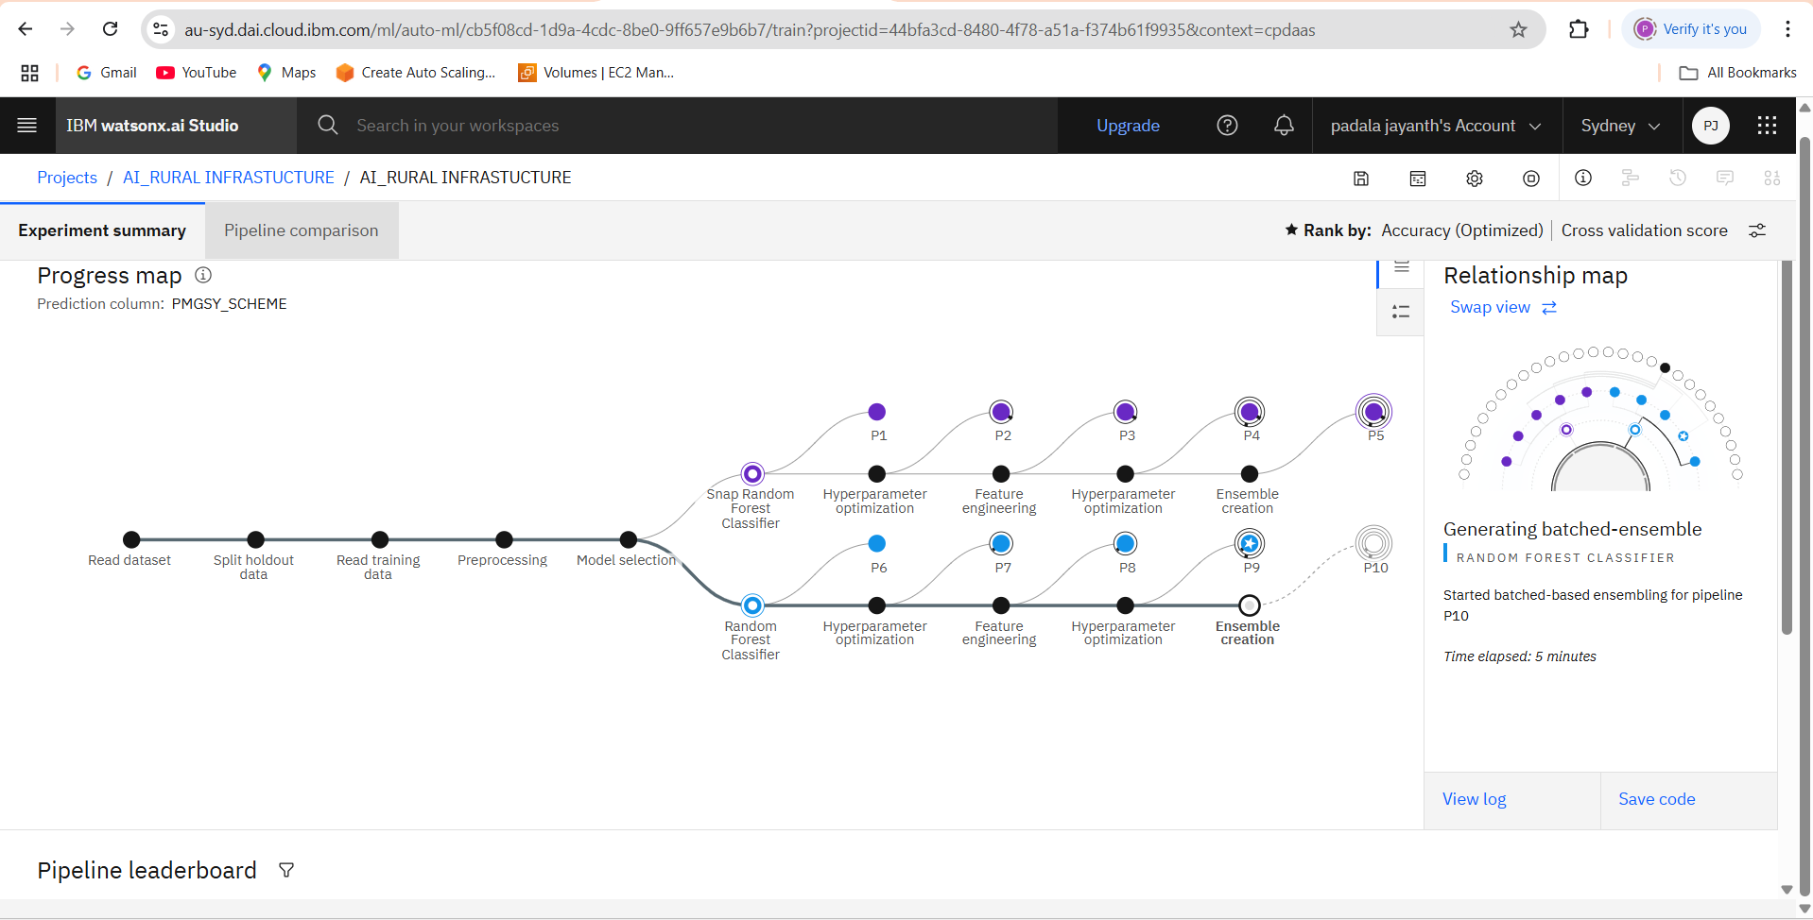
Results
REALATIONSHIP MAP

Slide 15
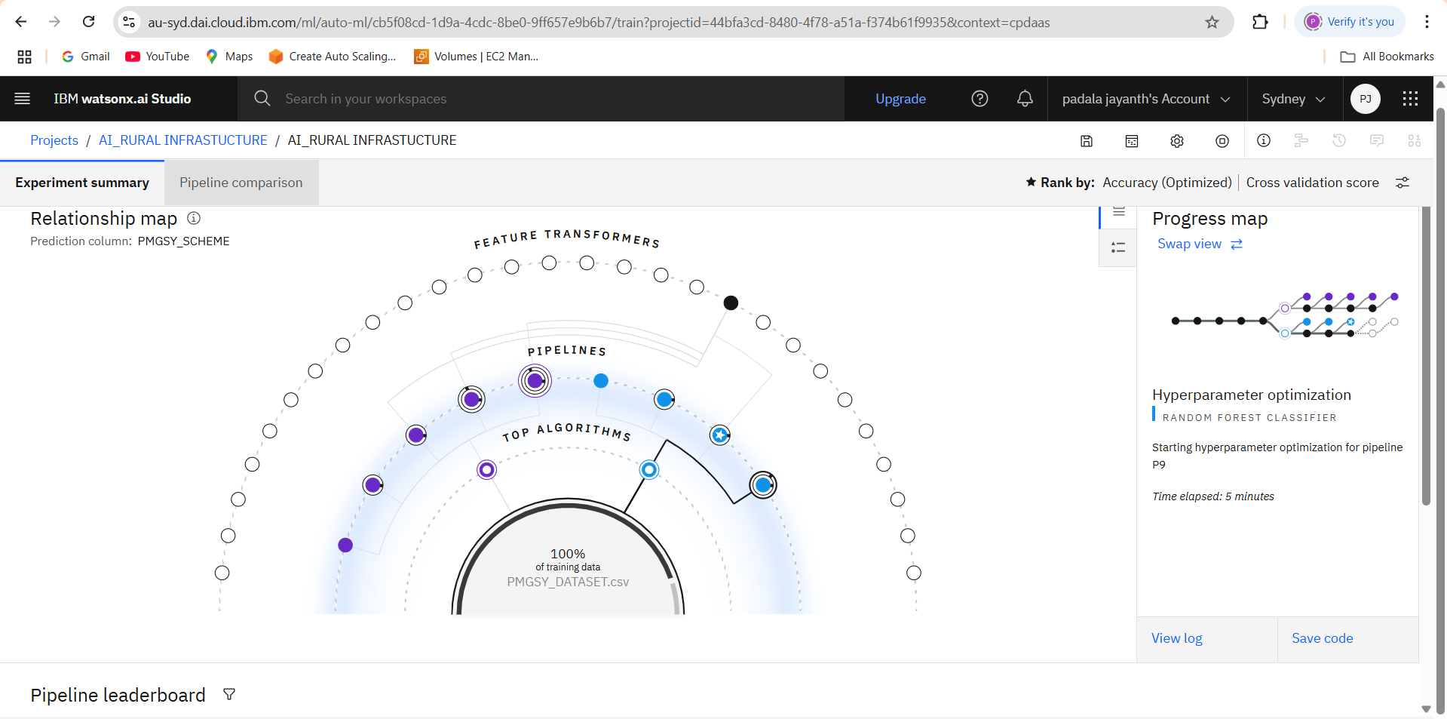
Results
PROGRESS MAP

Slide 16
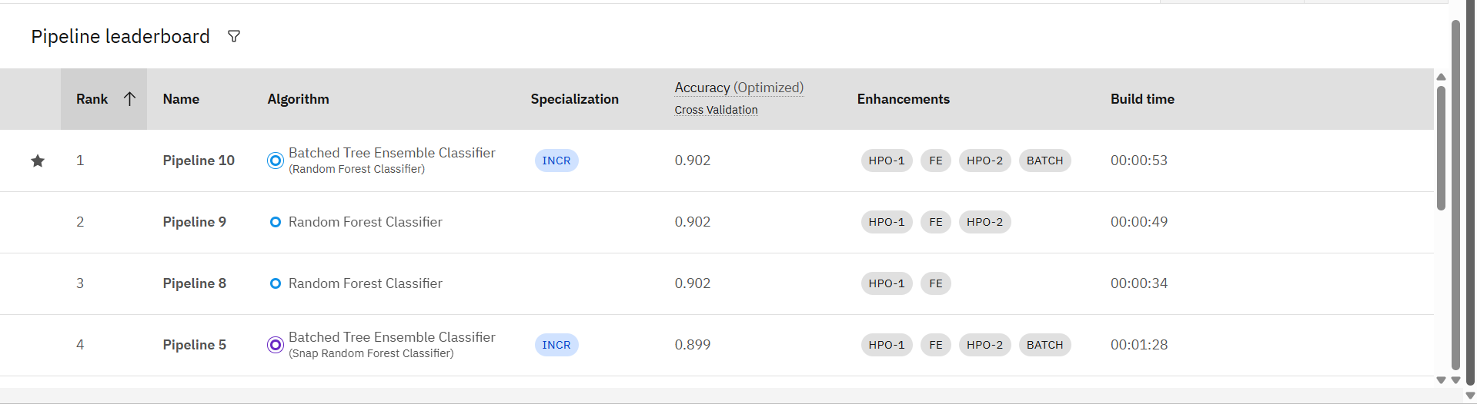
Results
PIPELINE LEADER BOARD

Slide 17
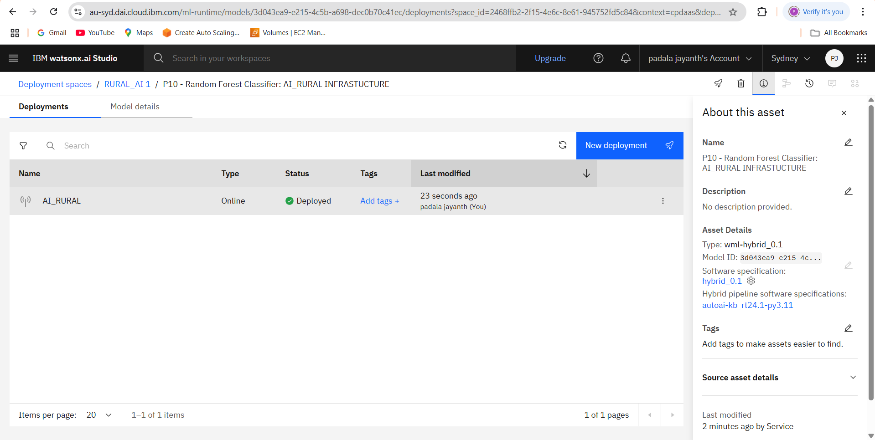
Results
DEPLOYED MODEL

Slide 18
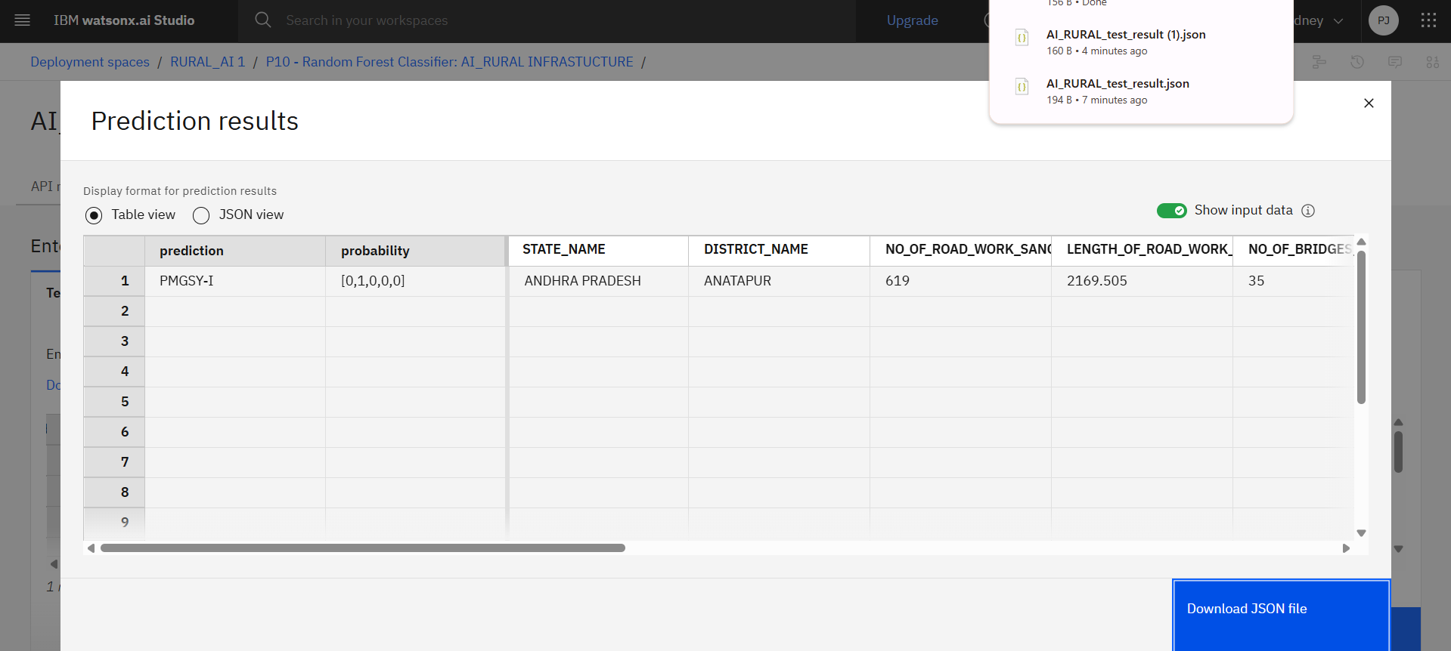
Results
PREDICITION RESULTS

Slide 19
Conclusion
This project solves a real-world problem using the power of AI and IBM Cloud services.
It automates a complex classification task
Ensures government schemes are accurately tracked and managed
Reduces errors and manual workload
Scales easily to thousands of new infrastructure records
The approach demonstrates the value of combining open government data with enterprise-grade cloud AI tools like AutoAI.

Slide 20
Future scope
Add Location Features: Include GPS coordinates for better regional prediction
Time-Series Integration: Track how schemes evolve across time
Explainable AI (XAI): Add interpretability for planners
Integration with GIS/MIS Tools: Real-time visualization and alerts
Scale to Other Schemes: Adapt model for Pradhan Mantri Awas Yojana, Jal Jeevan Mission, etc.

Slide 21
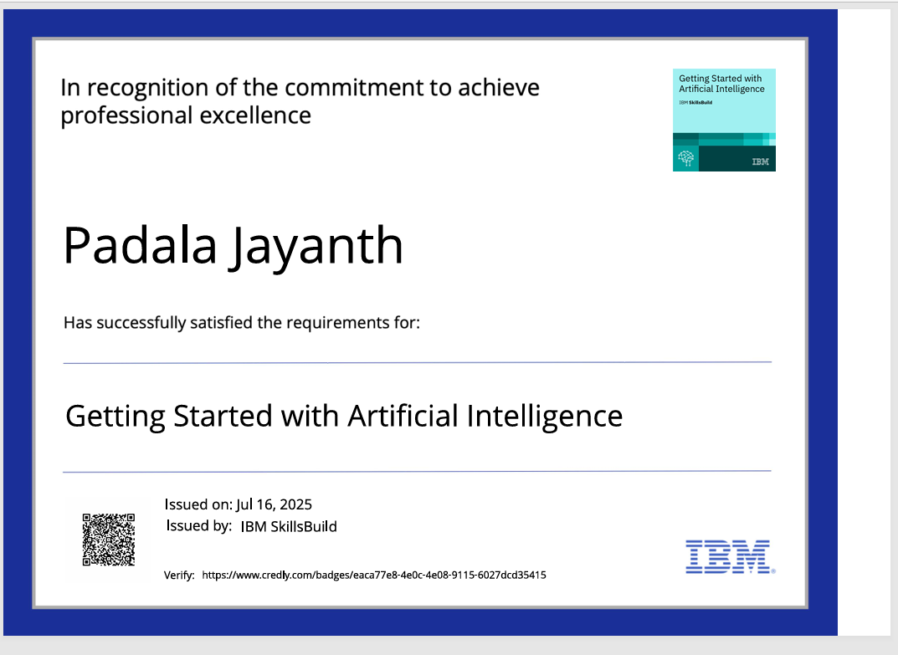
IBM Certifications
GETTING STARTED WITH AI

Slide 22
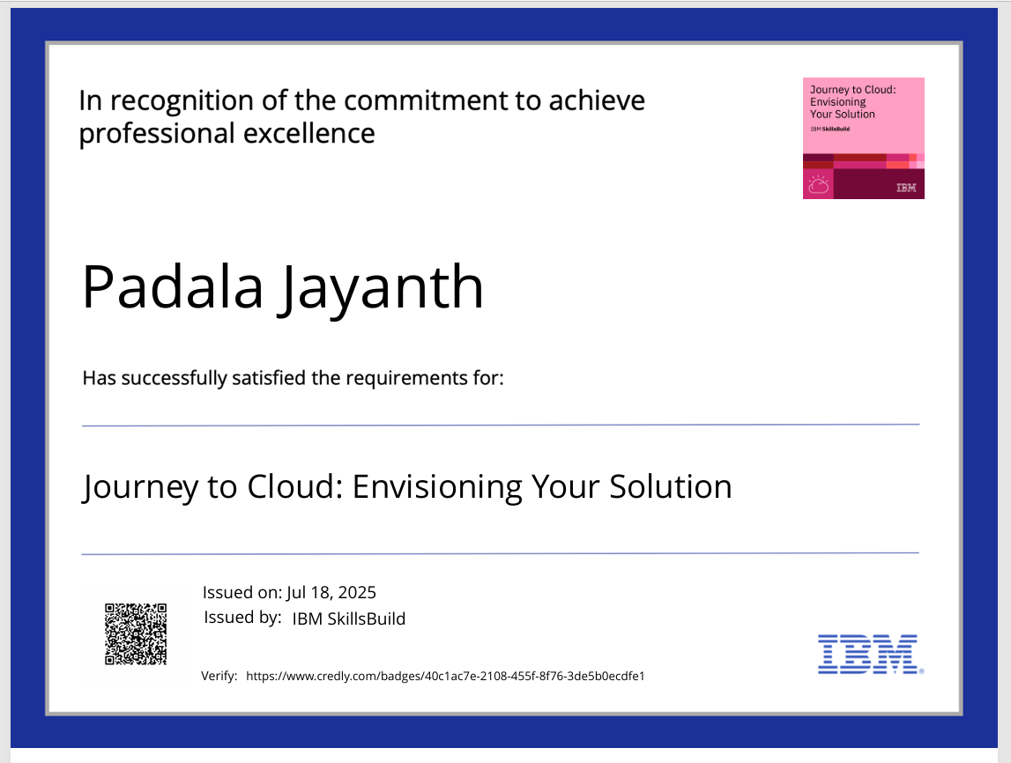
JOURNEY TO CLOUD

Slide 23
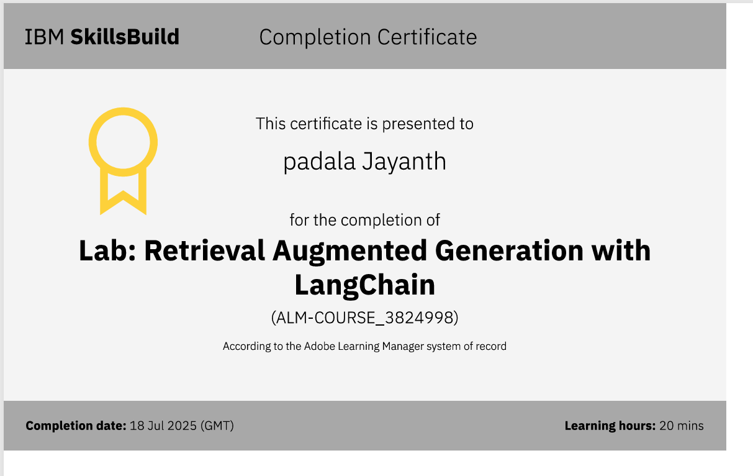
RAG WITH LANGCHAIN CERTIFICATE

Slide 24
GitHub Link
GITHUB LINK :- padalajayanth/RURAL_INFRASTUCTURE_PMGSY

Slide 25
THANK YOU

